Slide 1
Dijkstra’s Algorithm
Single Source Shortest Path

Slide 2
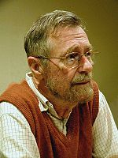
Edsger W. Dijkstra (1930-2002)
Dutch Computer Scientist
Received Turing Award for contribution to developing programming languages.
Contributed to :
Shortest path-algorithm, also known as Dijkstra's algorithm;
Reverse Polish Notation and related Shunting yard algorithm;
THE multiprogramming system;
Banker's algorithm;
Self-stabilization – an alternative way to ensure the reliability of the system.
www.math.bas.bg/.../EWDwww.jpg

Slide 3

Single-Source Shortest Path Problem
Single-Source Shortest Path Problem - The problem of finding shortest paths from a source vertex v to all other vertices in the graph.

Slide 4


Applications
- Maps (Map Quest, Google Maps)
- Routing Systems

Slide 5
Dijkstra's algorithm
Dijkstra's algorithm - is a solution to the single-source shortest path problem in graph theory.
Works on both directed and undirected graphs. However, all edges must have nonnegative weights.
Input: Weighted graph G={E,V} and source vertex v∈V, such that all edge weights are nonnegative
Output: Lengths of shortest paths (or the shortest paths themselves) from a given source vertex v∈V to all other vertices

Slide 6
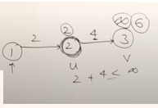
Relaxation
If(d[u]+c[u,v] < d[v] ) then
d[v] = d [u] + c[u,v]

Slide 7
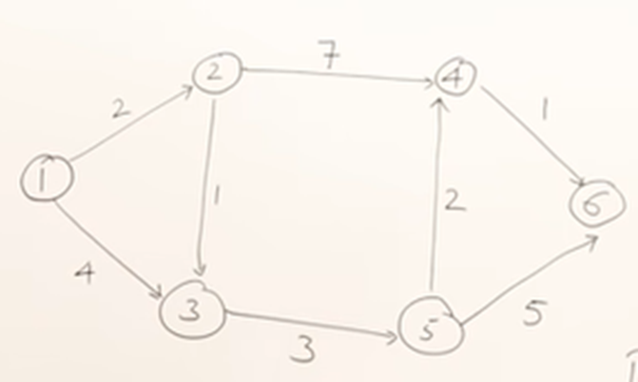

Slide 8
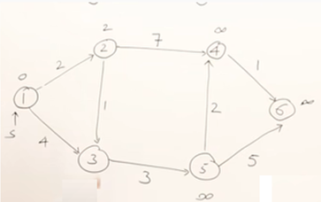
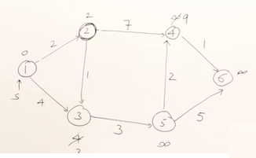

Slide 9
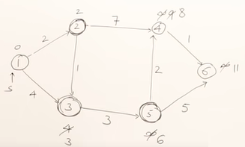
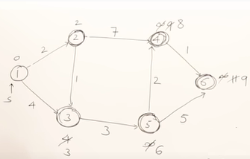

Slide 10

Example

Slide 11


Slide 12


Slide 13


Slide 14


Slide 15


Slide 16


Slide 17


Slide 18


Slide 19
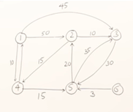
Another Example

Slide 20
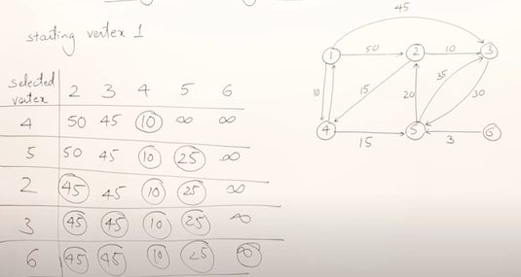

Another Example

Slide 21
Approach
The algorithm computes for each vertex u the distance to u from the start vertex v, that is, the weight of a shortest path between v and u.
the algorithm keeps track of the set of vertices for which the distance has been computed, called the cloud C
Every vertex has a label D associated with it. For any vertex u, D[u] stores an approximation of the distance between v and u. The algorithm will update a D[u] value when it finds a shorter path from v to u.
When a vertex u is added to the cloud, its label D[u] is equal to the actual (final) distance between the starting vertex v and vertex u.

Slide 22
The algorithm procedure is given below:
1. A tentative distance value is assigned to every node; this value is set to zero for the initial node, and to infinity for all other nodes.
2. All nodes unvisited are marked, and the initial node is set as current. An unvisited set ( a set of all the unvisited nodes) consisting of all the nodes is created.

Slide 23
3. For the current/initial node, take into account all the unvisited nearby nodes, and calculate their tentative distances. Make a comparison of the current assigned value and the newly calculated tentative distance; assign the smaller value.
  For example: if the current/initial node X was marked with a distance of 4, and the edge connecting it with a nearby neighbour node Y has length 1, then the distance through X to Y will be 4 + 1 = 5. If Y was previously assigned a value greater than 5, then change it to 5. Otherwise, keep the value as it is.

Slide 24
4. A visited node is never to be checked again. So, after finishing above steps with all the neighbours of the current node, make that node as visited and remove is from the unvisited set.
5. Stop the algorithm if, when planning a route between two specific nodes, the destination node has been marked visited.
6. Also, stop the algorithm if, when planning a complete traversal, the smallest tentative distance among the nodes in the unvisited set is infinity. This case is a result of no connection between the initial node and the remaining unvisited nodes.

Slide 25
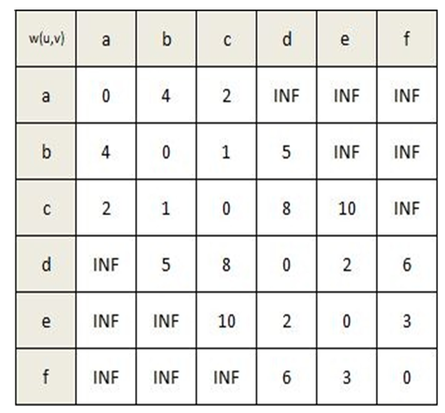
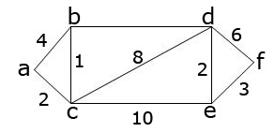
7. Find the unvisited node assigned with the smallest tentative distance value, and this will be the new “current mode”. Go back to step 3, and continue.
5

Slide 26
Example: Initialization
Distance(source) = 0
0
∞
Distance (all vertices but source) = ∞
A
2
B
4
1
3
10
∞
C
2
D
2
E
∞
5
8
∞
4
6
F
1
G
∞
∞
Pick vertex in List with minimum distance.

Slide 27
Example: Update neighbors' distance
0
2
A
2
B
4
1
3
10
∞
C
2
D
2
E
∞
5
8
1
4
6
Distance(B) = 2
F
1
G
Distance(D) = 1
∞
∞

Slide 28
Example: Remove vertex with minimum distance
0
2
A
2
B
4
1
3
10
∞
C
2
D
2
E
∞
5
8
1
4
6
F
1
G
∞
∞
Pick vertex in List with minimum distance, i.e., D

Slide 29
Example: Update neighbors
0
2
A
2
B
4
1
3
10
3
C
2
D
2
E
3
5
8
1
4
6
Distance(C) = 1 + 2 = 3 Distance(E) = 1 + 2 = 3 Distance(F) = 1 + 8 = 9 Distance(G) = 1 + 4 = 5
F
1
G
9
5

Slide 30
Example: Continued...
Pick vertex in List with minimum distance (B) and update neighbors
0
2
A
2
B
4
1
3
10
3
C
2
D
2
E
3
5
8
1
4
6
Note : distance(D) not updated since D is already known and distance(E) not updated since it is larger than previously computed
F
1
G
9
5

Slide 31
Example: Continued...
Pick vertex List with minimum distance (E) and update neighbors
0
2
A
2
B
4
1
3
10
3
C
2
D
2
E
3
5
8
1
4
6
F
1
G
No updating
9
5

Slide 32
Example: Continued...
Pick vertex List with minimum distance (C) and update neighbors
0
2
A
2
B
4
1
3
10
3
C
2
D
2
E
3
5
8
1
4
6
Distance(F) = 3 + 5 = 8
F
1
G
8
5

Slide 33
Example: Continued...
Pick vertex List with minimum distance (G) and update neighbors
0
2
A
2
B
4
1
3
10
3
C
2
D
2
E
3
5
8
1
4
6
F
1
G
Previous distance
6
5
Distance(F) = min (8, 5+1) = 6

Slide 34
Example (end)
0
2
A
2
B
4
1
3
10
3
C
2
D
2
E
3
5
8
1
4
6
F
1
G
6
5
Pick vertex not in S with lowest cost (F) and update neighbors

Slide 35
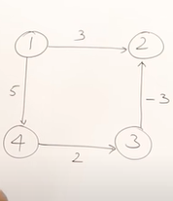
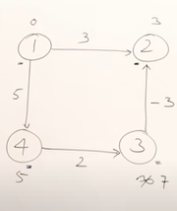
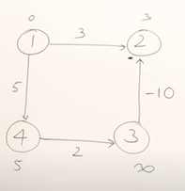
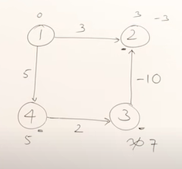
Drawback of Dijkstra’s Algorithm

Slide 36
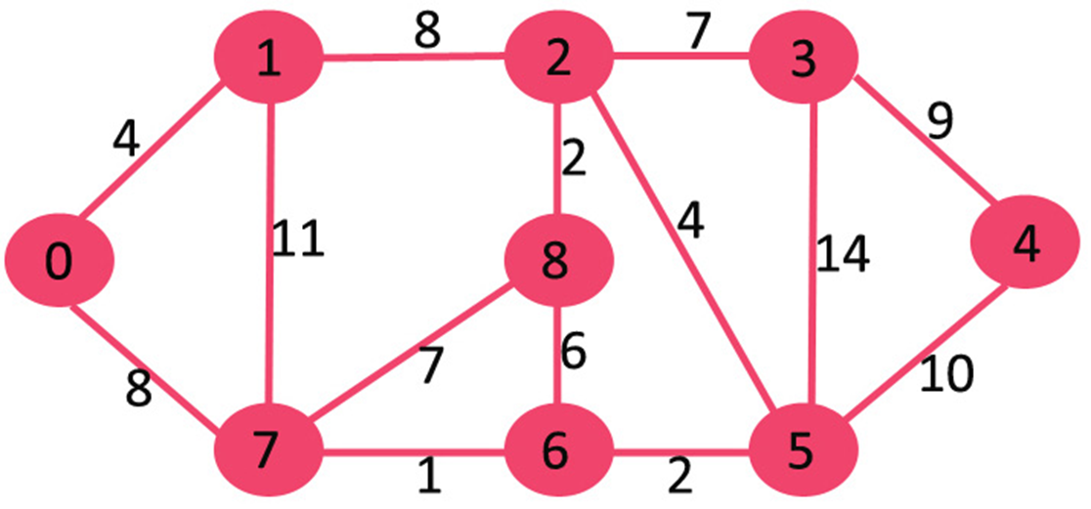
Try with this graph

Slide 37
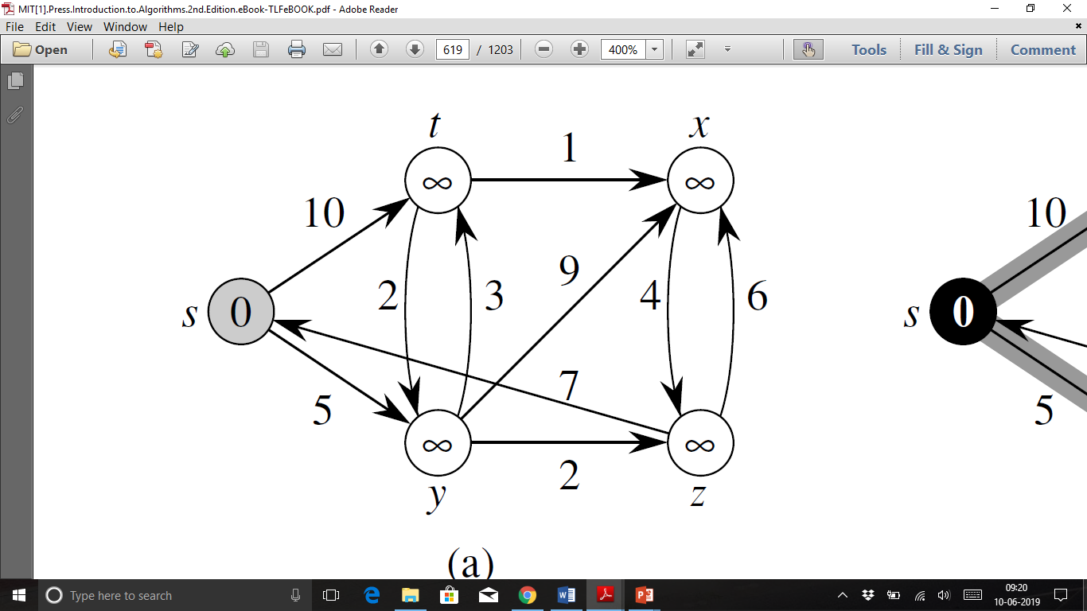
HOME WORK

Slide 38

Dijkstra’s Pseudo Code
Graph G, weight function w, root s
relaxing edges

Slide 39
Dijkstra pseudo code
Pseudo Code for Dijkstra’s Algorithm:
function Dijkstra(Graph, source):
dist[source] := 0
// Distance from source to source
for each vertex v in Graph:
// Initializations
if v ≠ source
dist[v] := infinity
// Unknown distance function from
source to v
previous[v] := undefined
// Previous node in optimal path from source
end if
add v to Q
// All nodes initially in Q
end for
while Q is not empty:
// The main loop
u := vertex in Q with min dist[u]
// Source node in first case remove u from Q
for each neighbour v of u:
// where v has not yet been removed from Q.
alt := dist[u] + length(u, v)
if alt < dist[v]:
// A shorter path to v has been found
dist[v] := alt
previous[v] := u
end if
end for
end while
return dist[], previous[]
end function

Slide 40

Correctness :“Cloudy” Proof
When a vertex is added to the cloud, it has shortest distance to source.
Least cost node
P: Next shortest path from
inside the known cloud
v
THE KNOWN
CLOUD
competitor
v'
Source
If the path to v is the next shortest path, the path to v' must be at least as long. Therefore, any path through v' to v cannot be shorter!

Slide 41
Time Complexity: Using List
The simplest implementation of the Dijkstra's algorithm stores vertices in an ordinary linked list or array
  Good for dense graphs (many edges)
|V| vertices and |E| edges
Initialization O(|V|)
While loop O(|V|)
  Find and remove min distance vertices O(|V|)
Potentially |E| updates
    Update costs O(1)
Total time O(|V²| + |E|) = O(|V²| )

Slide 42
Time Complexity: Priority Queue
For sparse graphs, (i.e. graphs with much less than |V²| edges) Dijkstra's implemented more efficiently by priority queue
Initialization O(|V|) using O(|V|) buildHeap
While loop O(|V|)
    Find and remove min distance vertices O(log |V|) using O(log |V|) deleteMin
Potentially |E| updates
    Update costs O(log |V|) using decreaseKey
Total time O(|V|log|V| + |E|log|V|) = O(|E|log|V|)
|V| = O(|E|) assuming a connected graph

Slide 45
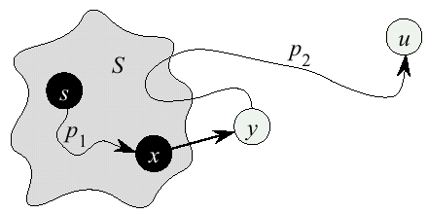
Dijkstra’s Correctness
We will prove that whenever u is added to S, d[u] = δ(s,u), i.e., that d[u] is minimum, and that equality is maintained thereafter
Proof
  Note that φορ αλλ v, d[v] ≥ δ(s,v)
  Let u be the first vertex picked such that there is a shorter path than d[u], i.e., that d[u] > δ(s,u)
  We will show that this assumption leads to a contradiction

Slide 46
Dijkstra Correctness (2)
Let y be the first vertex ιν V – S on the actual shortest path from s to u, then it must be that d[y] = δ(s,y) because
  d[x] is set correctly for y's predecessor x ιν S on the shortest path (by choice of u as the first vertex for which d is set incorrectly)
  when the algorithm inserted x into S, it relaxed the edge (x,y), assigning d[y] the correct value

Slide 47
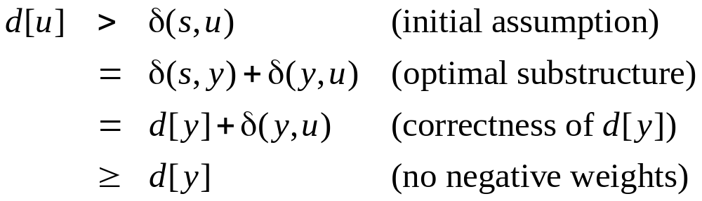
Dijkstra Correctness (3)
But if d[u] > d[y], the algorithm would have chosen y (from the Q) to process next, not u −− Contradiction
Thus d[u] = δ(s,u) at time of insertion of u into S, and Dijkstra's algorithm is correct

